Slide 1

PowerShell
10th Anniversary
Celebration Event
Powershell and the REST of the Things
Paul Amazona| Developer
Sebastian Szumigalski | System Engineer

Slide 2
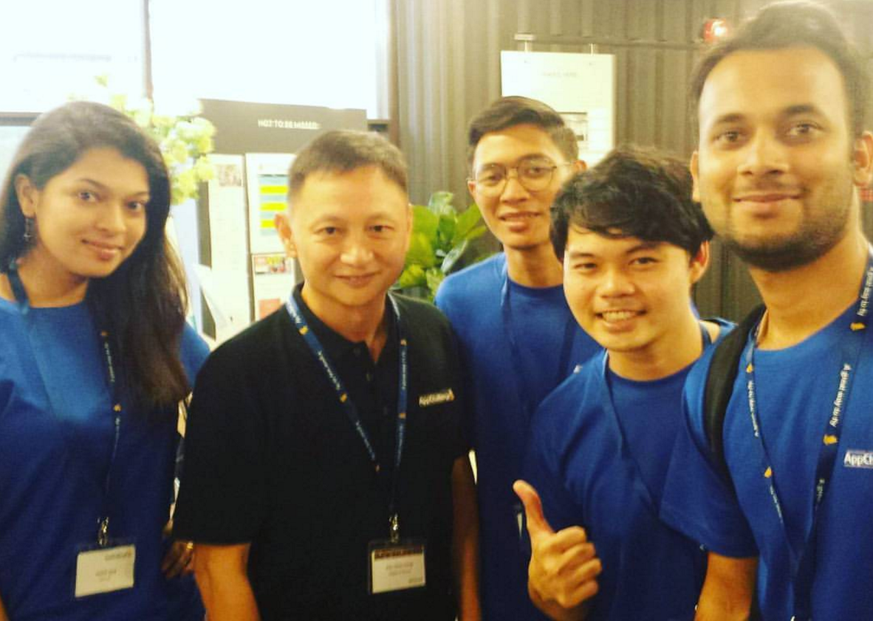
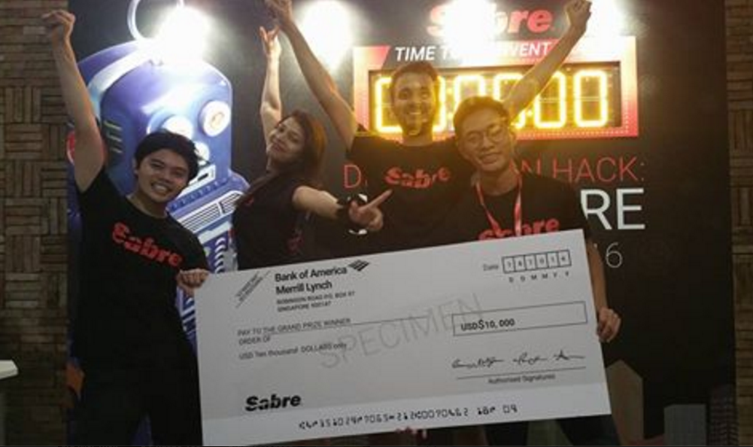

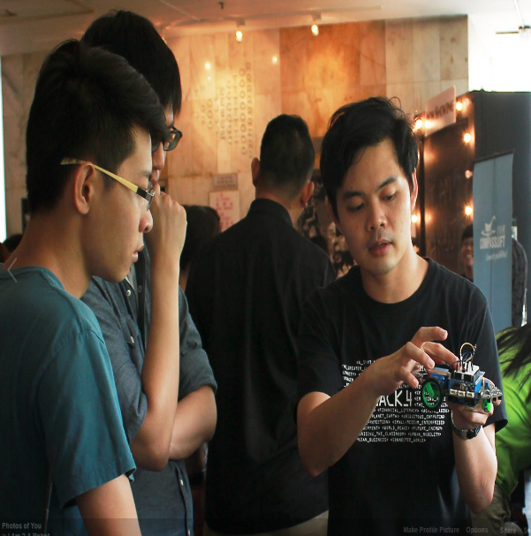
About Paul
MOOC Enthusiast
Meetup Junkie
Tech Hobbyist
Maker
Musician

Slide 4

REST APIs
Invoke-RestMethod

Slide 5
Demo

Slide 6

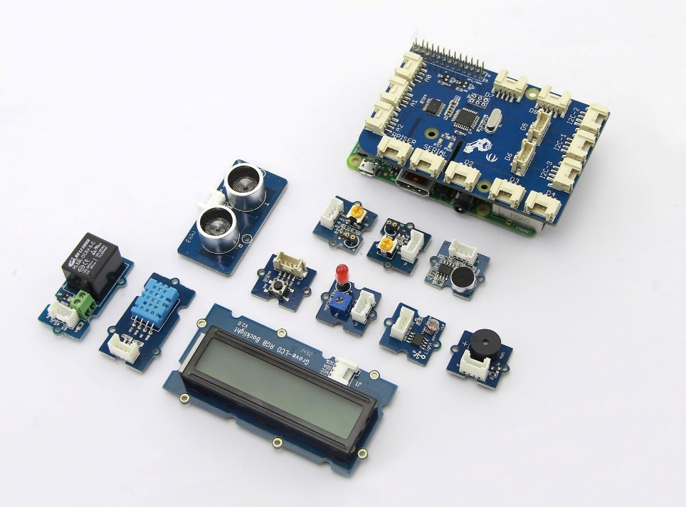


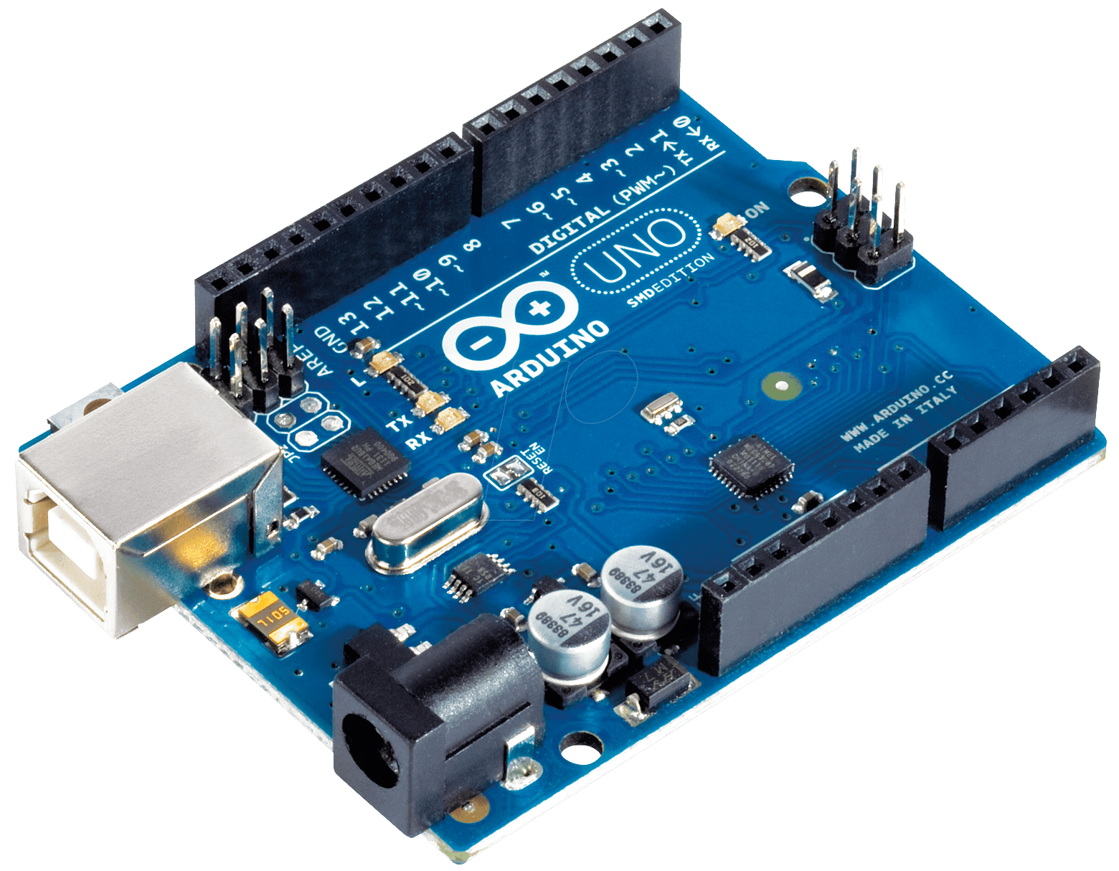

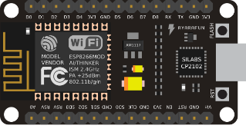

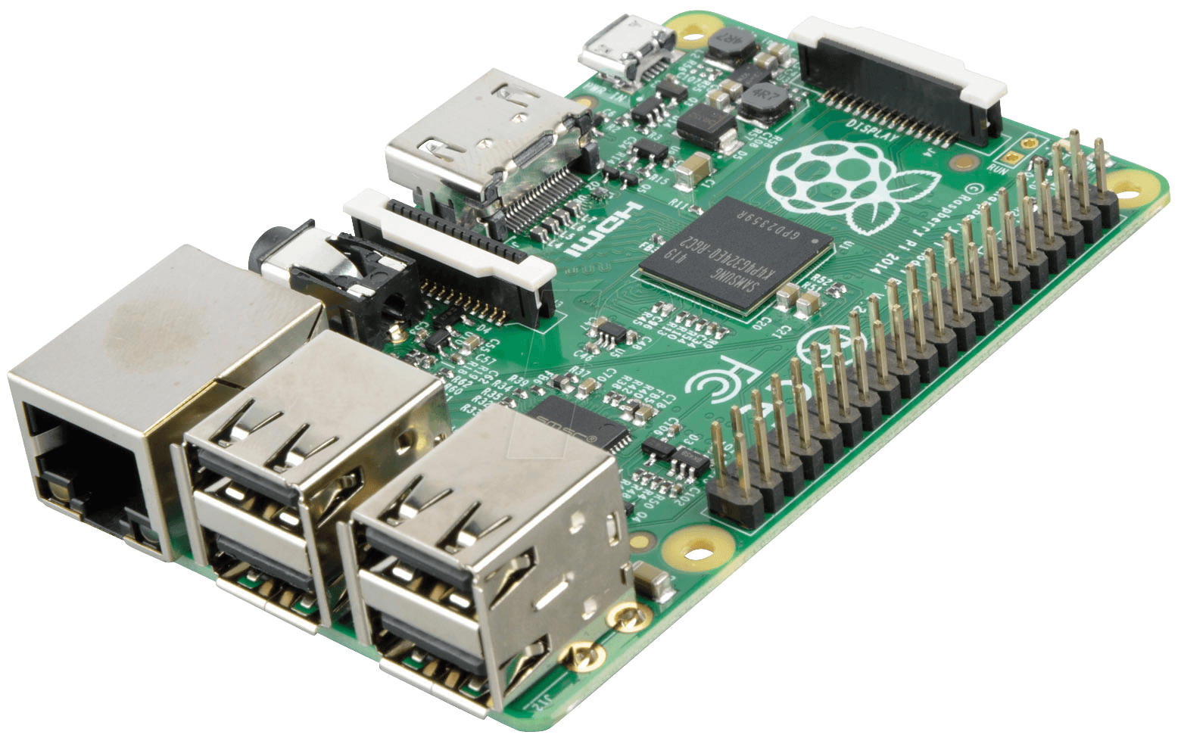

Slide 7



Slide 8
There’s More!
Go to Channel9.Msdn.Com for more great videos from the PowerShell 10th Anniversary Celebration!
All the stuff presented will be saved and made available for you to enjoy on Channel 9
You can follow us on Twitter with #PowerShell10Year, and @PowerShell_Team
Notes:
Please use this as the final slide.

